Slide 1
Little Man Computer
Definition
Some Hardware Characteristics
Major Ideas and Concepts
Little Man Computer - Layout and Components
Little Man - Computer Operation
The Instruction Set
Instruction Set Format
The Instructions
The Instruction Cycle
Von Neumann Architecture

Slide 2
Definition
Hardware is the physical equipment
that comprises a computer system
or
“Software that is crystallized early”
Source: Dr. Alan Kay
Xerox, Corp 1992

Slide 3
Characteristics
Components
Input
Processing
Output
Storage

Slide 4
Major Ideas and Concepts
Stored computer concept
Equivalence and interchangeability of program code and data
Basic instruction set
Way instructions are formatted
Basic concept of addressing of data
Fetch-execute cycle

Slide 5
Little Man Layout
Components
100 Mailboxes, numbered from 00 to 99
Calculator
2-digit instruction location counter
In-basket
Out-basket

Slide 6
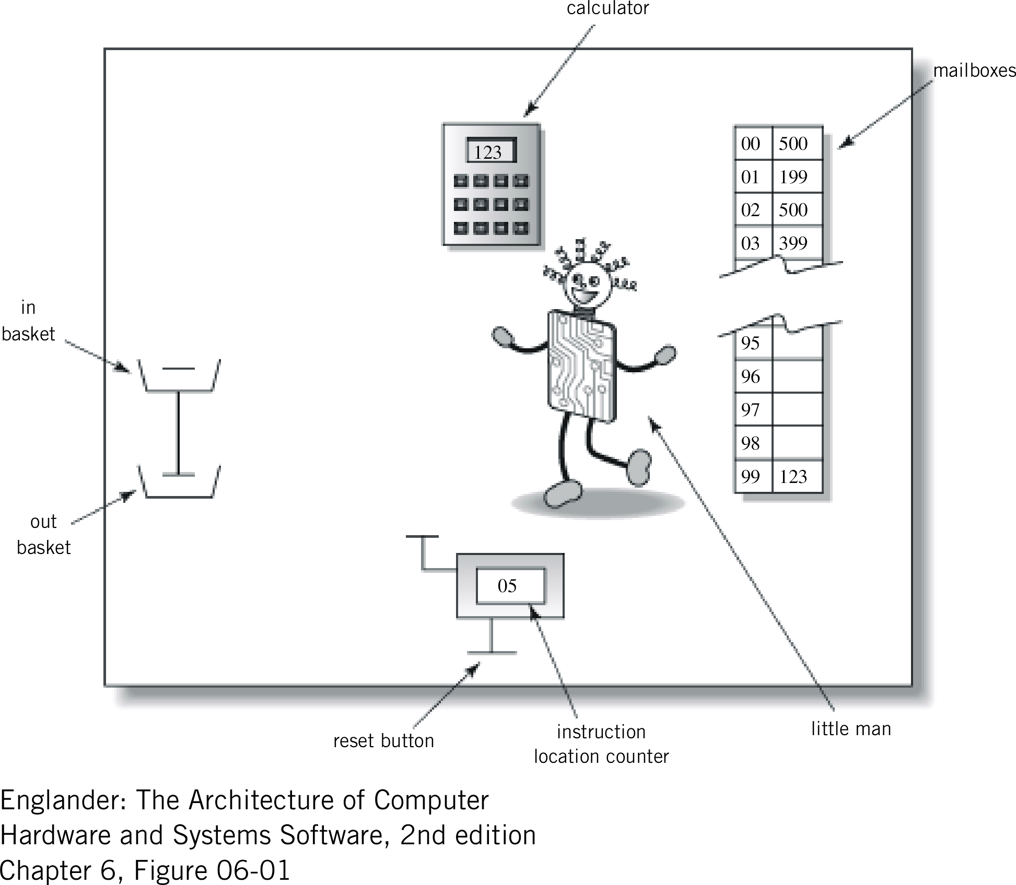
Figure 6.1 The Little Man Computer Operation

Slide 7
Instruction Set
Repertoire of different commands
Associated command formats
Format varies by equipment manufacturer
Proprietary
Performance or functionally advantage over competition

Slide 8
Instruction Set Format
1st digit
2nd and 3rd digits
Operation code
Mailbox Address

Slide 9
The Instructions
Load Instruction – op code 5
Store Instruction – op code 3
Add Instruction – op code 1
Subtract Instruction – op code 2
Input Instruction – op code 9, address 01
Output Instruction – op code 9, address 02
Halt (stop) Instruction – op code 0

Slide 10
More Instructions
Branch Unconditionally Instruction – op code 6
Branch on Zero Instruction – op code 7
Branch Positive Instruction – op code 8

Slide 11
Let’s Write a Program
Write a Little Man computer program using the instruction set we just discussed to:
Add the 3 numbers 100, 200 and 300 together from the in-basket.
Save them individually in mailboxes 91, 92 and 93 respectively.
Place the resulting sum in mailbox 99 and in the out-basket.

Slide 12
Does it look like this?
Mail Instruction Comments
00 9 01 Input 1st number
01 3 91 Store 1st number in Mailbox 91
02 9 01 Input 2nd number
03 3 92 Store 2nd number in mailbox 92
04 9 01 Input 3rd number
05 3 93 Store 3rd number in mailbox 93
05 1 91 Add 1st number to the 3rd
06 1 93 Add 2nd to the sum of 1st & 3rd
07 3 99 Save sum in mailbox 99
08 9 02 Send sum to out-basket
09 0 00 Stop
91 100 Data – first number
92 200 Data – second number
93 300 Data – third number
99 600 Data - Resulting sum

Slide 13
The Instruction Cycle
Cycle comes in two parts:
  Fetch portion – finds and retrieve instruction to execute
  Execute portion – actually performs the work of the specified instruction
Intel example: 2.5 gigahertz
z13 example: 5.3 gigahertz

Slide 14
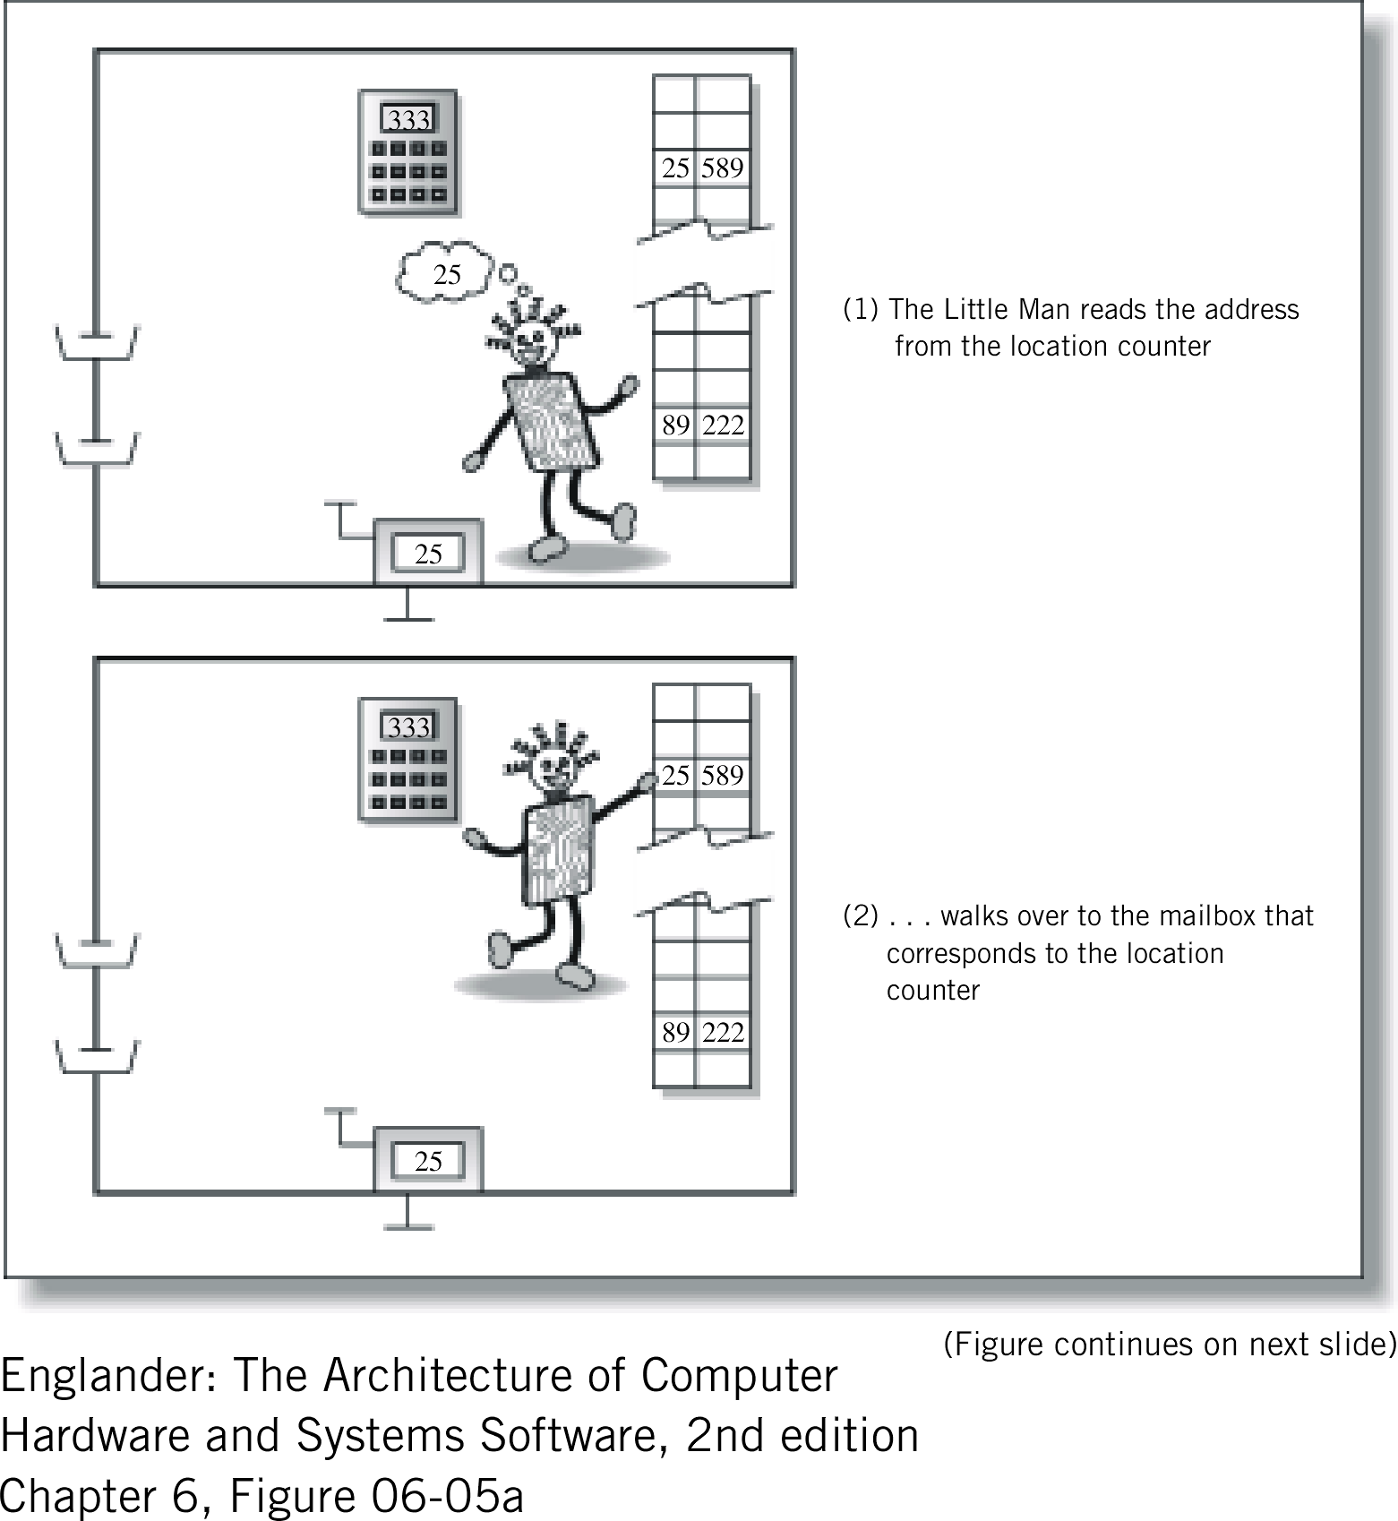
Figure 6.5a The fetch portion of the instruction cycle

Slide 15
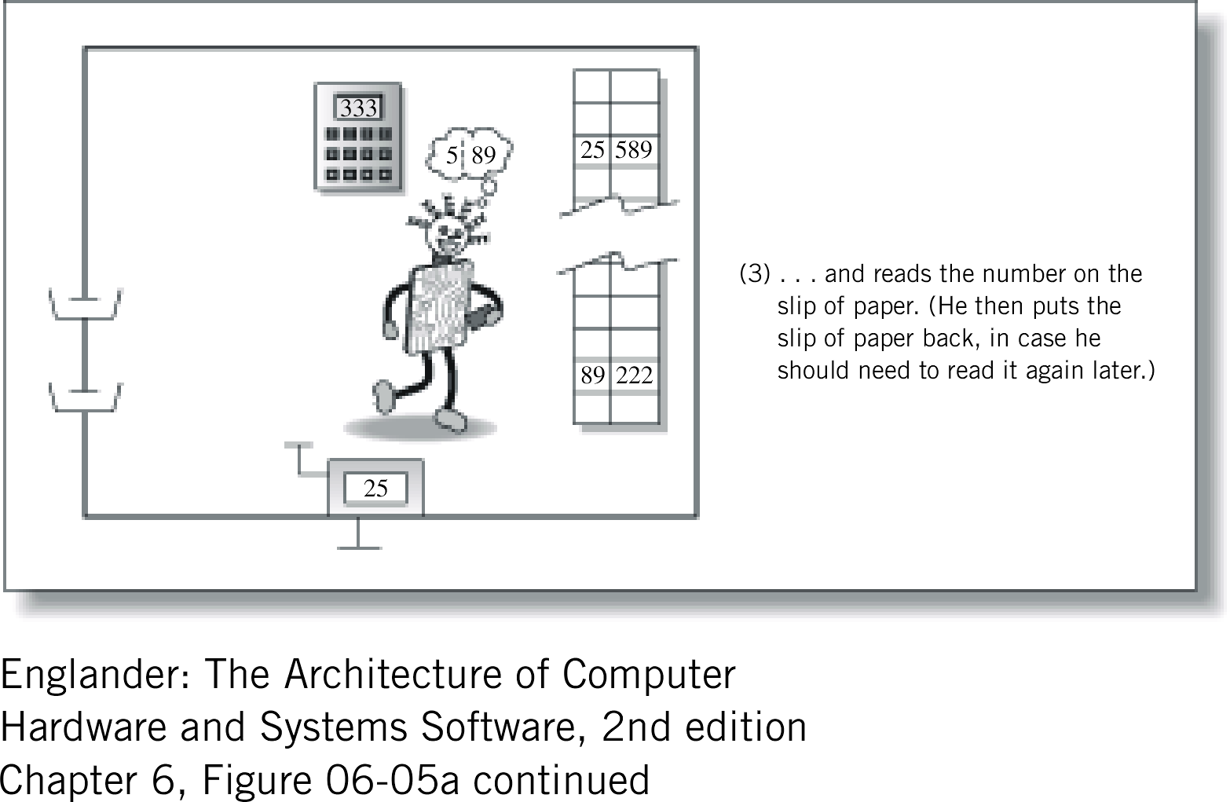
Figure 6.5a (continued)

Slide 16
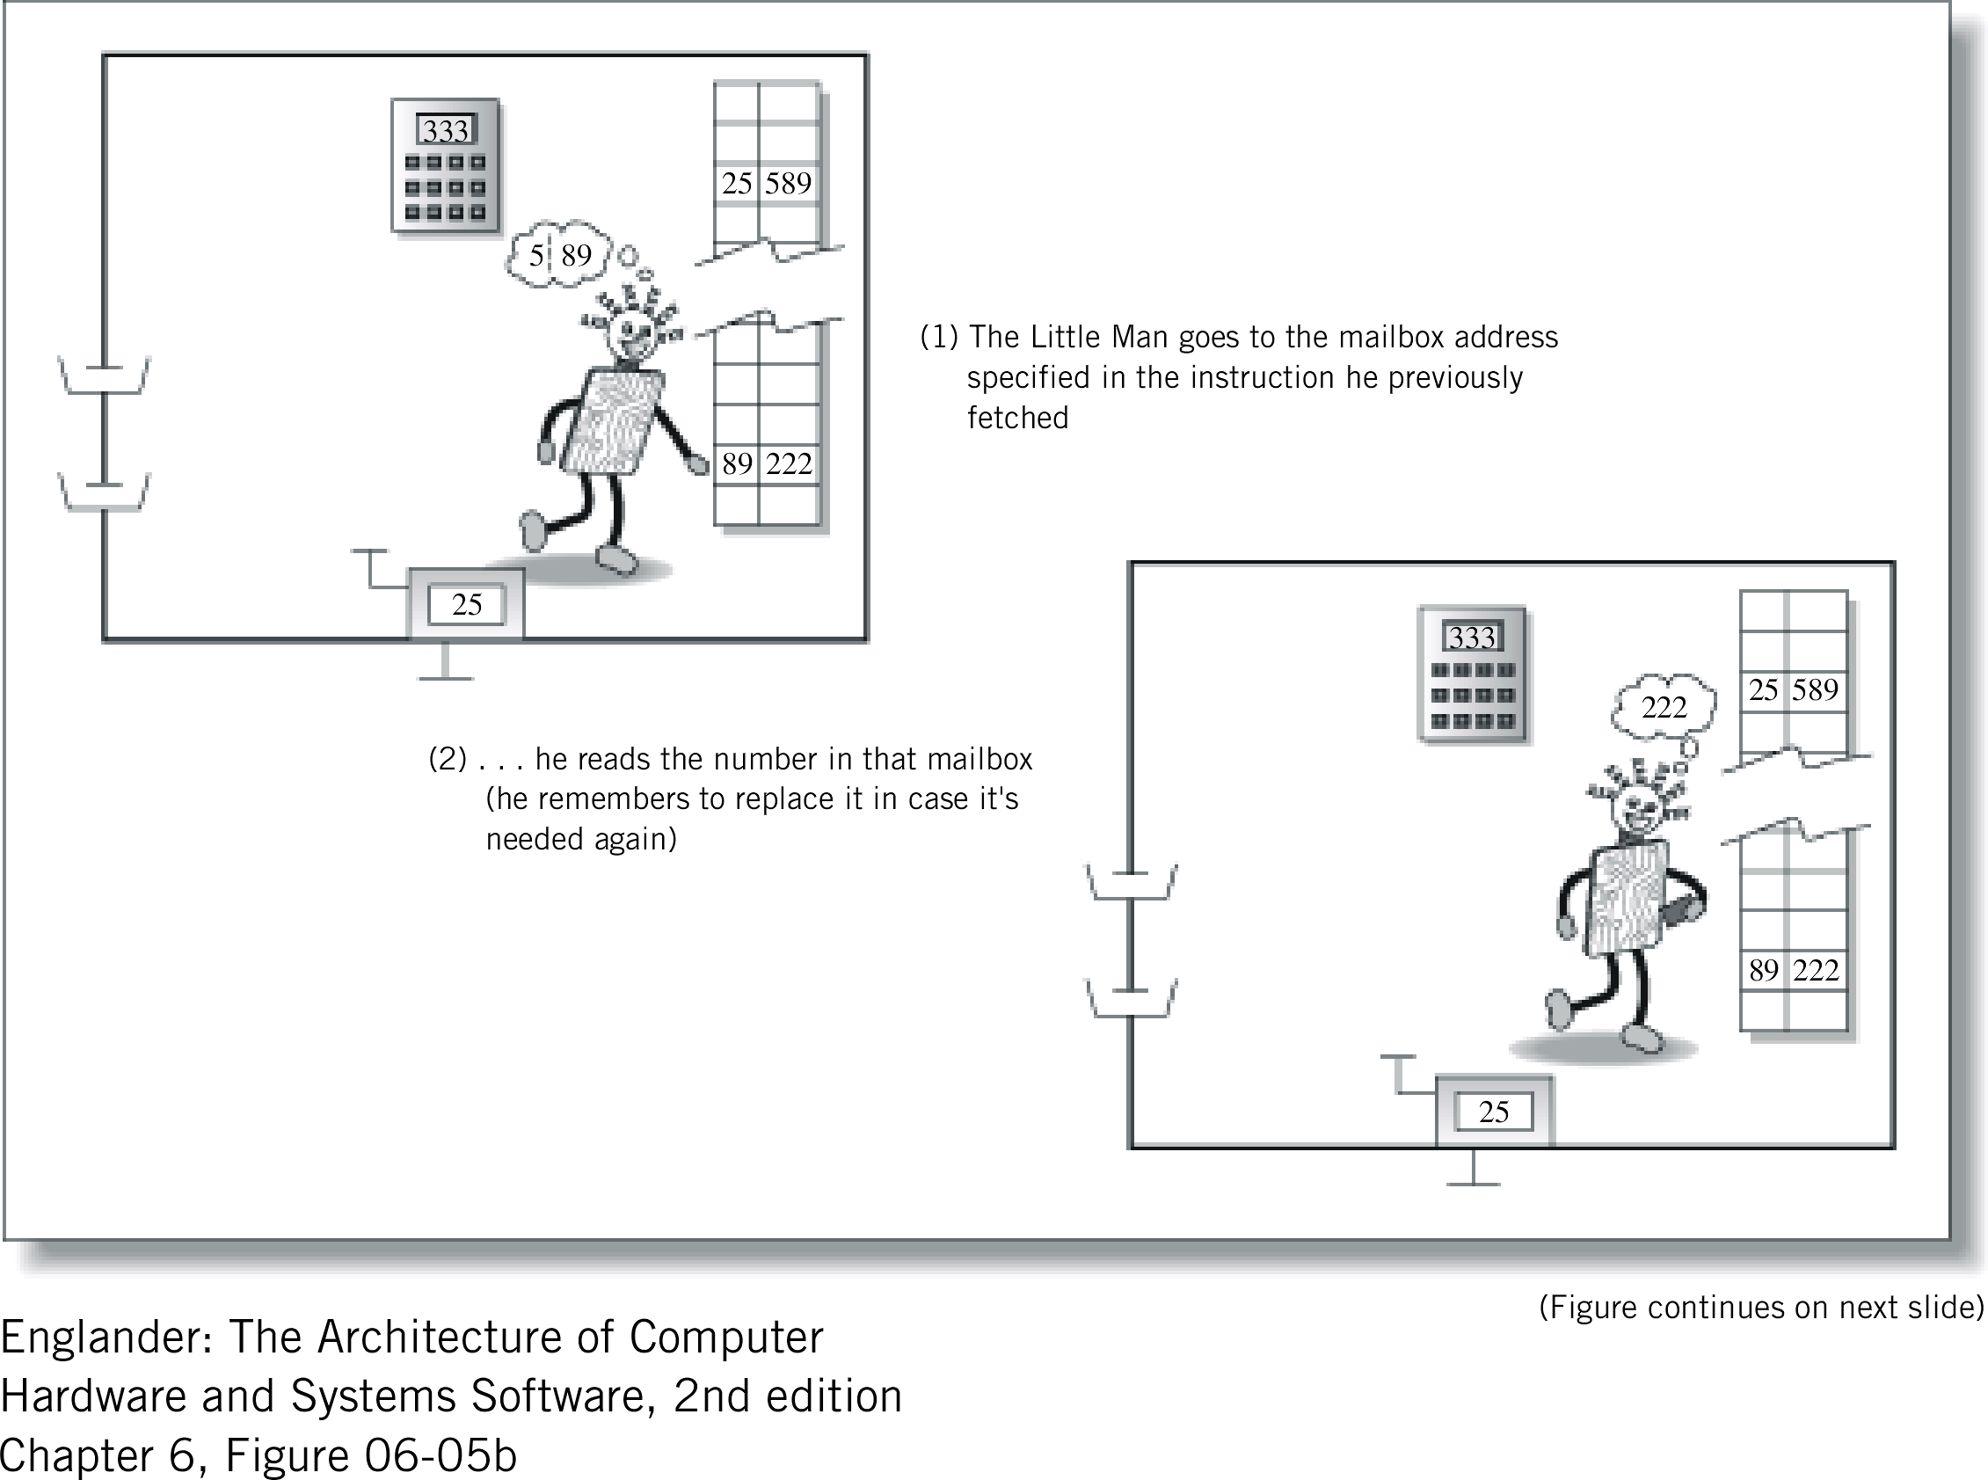
Figure 6.5b The execute portion of the instruction cycle (LOAD instruction)

Slide 17
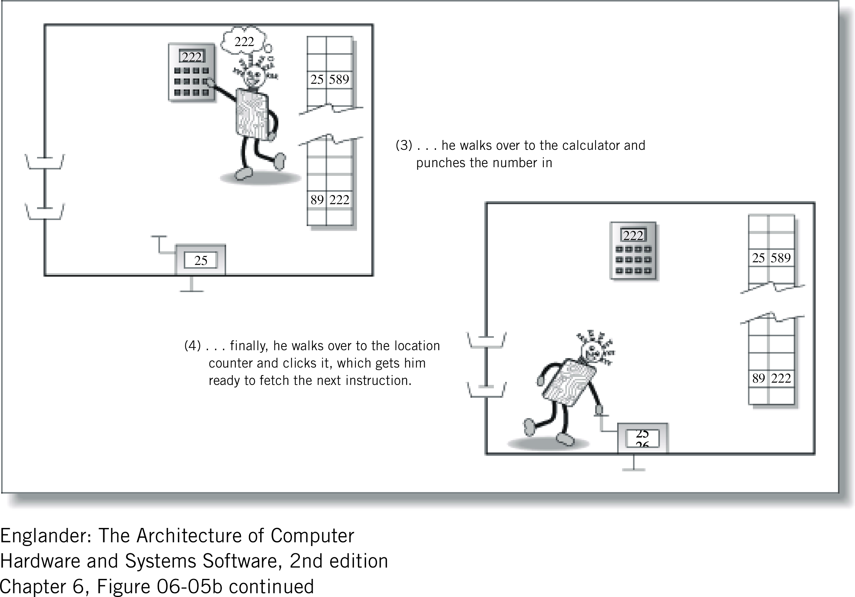
Figure 6.5b (continued)

Slide 18
Von Neumann Architecture
Father of the modern computer
Control unit that executes instructions
Arithmetic/logic unit
  performs arithmetic and logic calculations
Memory holds both programs and data
Memory is addressed linearly
Memory is addressed by location number
Instructions are executed sequentially

Slide 19
Next Time
The CPU and Memory

